Slide 1
Importance of
Post Match Analysis

Slide 2
Aims
To provide a structured approach to giving feedback
To ensure all the key messages you have recorded are covered in the debrief
To prioritise the feedback
Timing of Feedback

Slide 3
The Post Match Analysis
Agree a time with the referee when you can conduct the debrief
Find a quiet place to reflect on the performances
Summarise the key points you are going to use from the notes you have taken (prioritise)
Use the sections of the assessment form as a basis for the structure
Important that nothing is missed

Slide 4
7 Step - Feedback Model
3
1
Game Context
Explain impact on the game
2
Refer to specific incidents
7
Referee
ARs
4th Official
Leave on a positive
4
Ask for their views
6
Offer Solutions
Express your opinion
5

Slide 5
The 7 Step Ladder
Model

Slide 6
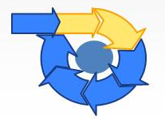
The 7 Step Ladder
Model Feedback
7
Leave on a Positive
6
Offer Solutions/Alternatives
Express your Observations/Opinions
5
4
Ask for their Views
3
Refer to Specific Match Incidents
2
Explain Impact on the game
1
Game Context

Slide 7
The 7 Step Ladder
The 1st Step
Describe the game – challenge or not
Attitude of players
Dominance of teams
Playing conditions
Game Context

Slide 8
The 7 Step Ladder
The 2nd Step
Impact on the game – Referee
Developing the team
Positive impact of the referee and ARs
Explain Impact on the game

Slide 9
The 7 Step Ladder
The 3rd Step
Key related decisions or incidents awarded or not
Posing Questions
Clarification of misconduct
Offer own observations
Refer to Specific Match Incidents

Slide 10
The 7 Step Ladder
The 4th Step
Seek their opinions on incidents (Referee or Assistant Referee) i.e. talk me through the incident in the 39th minute when you awarded a penalty kick to the home team. What did you see?
Ask for their Views

Slide 11
The 7 Step Ladder
The 5th Step
Honest opinion – either supporting the referee, assistant referee or not
Describe in your words what you saw
Express your Observations/Opinions

Slide 12
The 7 Step Ladder
The 6th Step
Incorrect Decision – What should you have done?
What can we learn from this?
Is there anything else you could have taken into consideration?
Offer solutions to the match official – use your experience
Need to be strong and give opinion
Must be correct in Law
Offer Solutions/Alternatives

Slide 13
The 7 Step Ladder
The 7th Step
Leave on a positive
Summarise the performances – revisit the game context
Acknowledge the type of game – was it challenging or not
Offer support
Clarify when you will review DVD incidents
Thank them for making you part of the team
Leave on a Positive

Slide 14
7 Step - Feedback Model
3
1
Game Context
Explain impact on the game
2
Refer to specific incidents
7
Referee
ARs
4th Official
Leave on a positive
4
Ask for their views
6
Offer Solutions
Express your opinion
5

Slide 15
Any Questions?

Slide 16
Group Exercise

Slide 17
Group Exercise
Everton v Wolverhampton Wanderers
Two penalty incidents 43rd & 76th Minutes
Discuss, agree and plan how you would deal with both incidents during the debrief of the referee and his team.
Consider using the 7 Step Ladder approach

Slide 18


Slide 19
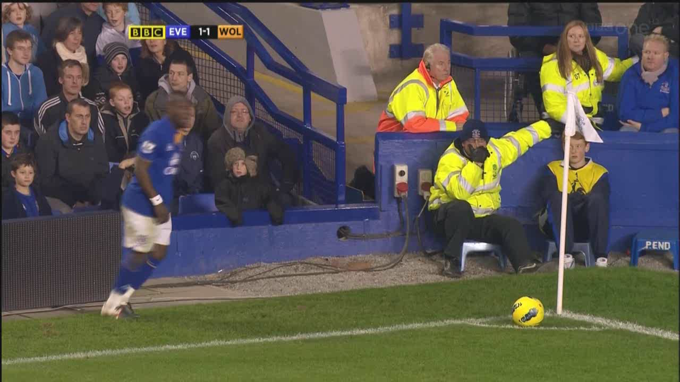

Slide 20
Summary
Timing of the debrief
Structured post match analysis - prioritise
7 Step Ladder Model
Honesty in the feedback
Agree any actions

Slide 21
Thank you

